Slide 1

Participatory Monitoring
and Evaluation
in Tanzania’s Health and
Social Service Programmes
Training Presentation
Mary Freyder, MPH
MEASURE Evaluation-Tanzania
2017

Slide 2
Welcome and Orientation
Notes:
[List the names of the trainers on the slide.]
Introduce yourself and any other trainers.
Briefly describe the training’s logistics: days, timeframe, facilities.

Slide 3
Day 1
Session 1: Introduction to PM&E
Module 1: What is Participatory Monitoring and Evaluation?
Module 2: How Can a Simple M&E Model Be Used to Tell a Story?
Lunch
Module 3: What Are the Benefits of Adding a Participatory Approach to Traditional M&E?
Module 4: What Is the PM&E Programme Path?
Notes:
[Briefly review the 4-day programme agenda.]

Slide 4
Day 2
Session 2: PM&E Community Group Tools
Module 1: Vulnerability Map
Module 2: Community Concerns Brainstorm
Lunch
Module 3: Programme Action Calendar
Module 4: Community Monitoring Table

Slide 5
Day 3: Morning
Session 2: PM&E Tools (continued)
Module 5: Community Scorecard
Module 6: Single Case Review
Lunch

Slide 6
Day 3: Afternoon
Session 3: Reflection and Action
Module 1: Why Reflect?
Module 2: How to Reflect Using Information from Monitoring Activities
Module 3: How to Take Action
Session 4: Community Practice
Module 1: How to Prepare Your Community Meeting
Module 2: How to Facilitate a Meeting

Slide 7
Day 4
Session 4: Community Practice (continued)
Module 3: How to Conduct a Community Meeting Using PM&E Tools (field practice)
Lunch
Module 4: How to Share Field Practice Experiences and Evaluate PM&E Training

Slide 8
Session 1:
Introduction to PM&E
Notes:
[List the names of the trainers on the slide.]
Introduce yourself and any other trainers.
Briefly describe the training’s logistics: days, timeframe, facilities.

Slide 9
What Is PM&E?
Participation
Taking part in a joint activity
Sharing different experiences, capabilities, and knowledge with one another
Listening, learning, asking questions, and showing respect for all persons involved
Empowering the community
Notes:
Now let’s brainstorm what PM&E means.
First, let’s remember that brainstorming is simply sharing ideas. All ideas are welcome. Sharing openly, without judging or critiquing the ideas, helps us learn.
What do you think “participation” means?

Slide 10
What Is PM&E?
Monitoring
Watching
Checking
Looking for changes
Observing
Counting
Measuring
Gathering information
Tracking progress day to day
Notes:
What does monitoring mean?

Slide 11
What Is PM&E?
Evaluation
Assessing
Reflecting
Analysing
Learning
Making comparisons
Telling a story, with a beginning and an end
Notes:
What does evaluation mean?

Slide 12

Telling a Story with the M&E Model
Inputs
Activity
Outputs
Outcomes
Notes:
PM&E is what happens when you have participation, monitoring, and evaluation working together. It’s a method that engages and empowers communities through shared control, joint learning, and ongoing reflection, in order to better respond to concerns, improve progress, and achieve desired goals. It can help us tell a story about how we are doing and where we are going.
We can do this by using a simple M&E model, with inputs, activity, outputs, and outcomes.

Slide 13
Telling a Story with the M&E Model
Planting and watering
Planting with fruits and veggies
Fruits and veggies for family to eat
Seeds
Notes:
If you were to ask a family in need of nutritious food how they would like to address their concerns, they might suggest a backyard garden. The inputs might be seeds, the activity might be planting and watering, the outputs might be plants with fruits and veggies, and the outcome would be more fruits and veggies for the family to eat.

Slide 14
Telling a Story Using the M&E Model
If a community wanted to support a better future for vulnerable children, some of the members of the community might say that they could achieve this goal by supporting education for most vulnerable children.
Books and teachers
Children enrolled in school
Children learning
Community leaders
Notes:
Here’s what the model might look like.

Slide 15
Telling a Story with the M&E Model
Notes:
[Use flip-chart paper and group discussion to develop this model.]
Let’s try to tell another story using the simple M&E model.
What about a household with most vulnerable children?
What would we need to do to support a better future for those children?
What would be the inputs, the activity, the outputs, and the outcome?

Slide 16
Strong Goal Statements
Books and teachers
Children enrolled in school
Children learning
Community leaders
Goal statements clearly describe what you want to achieve.
Goal statements should be:
    Specific
    Measureable
    Time-bound
Notes:
Now we need to develop strong goal statements, with specific, measureable, time-bound elements that would help us understand what is needed for us to know what progress we are making.

Slide 17
Strong Goal Statements
Strong goal statement
Weak goal statement
Notes:
Here you can see the difference between weak goal statements and strong ones with specific, measureable, time-bound elements.
“Increase the number” allows for measurement.
“Meals where the family eats fruit and vegetables” is more specific than “nutritious meals.”
“This year” is time-bound.

Slide 18
What Is an Indicator?
Signal that helps us identify change
Detail in a story
Specific way to measure
Notes:
Strong goal statements include “indicators” that are specific, measurable, and time-bound. There is no right answer on which indicator to choose. Use your own judgment and relate it as closely as possible to the input, activity, output, or outcome.
If you choose people-related indicators, remember to separate people at least by gender, and then by age, location, or other dimensions that make sense. This is important, because people are not the same, and depending on their gender, age, and other background characteristics, their situations change.

Slide 19
Types of Indicators
Measurement: Height, weight, distance
Count: Number of kids
Observation: Child has a cough
Opinion: How clean is the health centre (very good, good, just okay, bad, very bad)?
Notes:
An indicator may be a fact, such as the weight of a child. You can measure the weight and note changes over time.
An indicator might also be an opinion or feeling. A mother could tell you that she was satisfied with her experience at the antenatal care (ANC) clinic or a child could say that he or she feels proud to receive uniforms to attend school.
Let’s use a real-life example. When we cook rice for ourselves and our families, we monitor how the rice cooks to be sure that it is cooked well and tastes good.
First, we gather our resources, or inputs: the water, pot, uncooked rice, and salt. We add water to the pot and set the fire. These are our activities. Then we monitor these processes to see when the water boils. Good indicators that the water has boiled are the bubbles and steam rising from the water. This tells us that we can add our rice.
When we add our rice to the boiling water, it gets softer over time; this is an output. We monitor this change using indicators, to determine whether our rice has been cooked well. Our indicators could be that the grain is soft and the taste is good. Once this happens, we have reached our outcome: we have rice to eat.

Slide 20
REVIEW
Telling a Story with the M&E Model
Planting and watering
Planting with fruits and veggies
Fruits and veggies for family to eat
Seeds
Notes:
Let’s review our previous M&E model depicting the story of a family in need of nutritious food. This model shows how they would like to address their concerns using a backyard garden. The inputs might be seeds, the activity might be planting and watering, the outputs might be plants with fruits and veggies, and the outcome would be more fruits and veggies for the family to eat.
Now let’s add more details to the story, such as:
The number of seeds the family bought this year
The number of days the family tended the garden this year
The number of plants that produced fruits or vegetables this year
The number of family meals with fruits or vegetables this year
Indicators can also reflect opinions and feelings:
How easy is it to get enough seeds to plant?
How confident is the family about their ability to take care of the garden?
How big are the fruits or vegetables this year?
Why did the family not have as many fruits and vegetables as they expected this year?

Slide 21
REVIEW
Telling a Story Using the M&E Model
Books and teachers
Children enrolled in school
Children learning
Community leaders
If a community wanted to support a better future for vulnerable children, some of the members of the community might say that they could achieve this goal by supporting education for most vulnerable children.
Notes:
Let’s review how we depicted the story of the community that wanted to support a better future for vulnerable children.
Can we provide more specific details/indicators? [Solicit their suggestions, and some as needed, such as the following:]
How many children are provided with school materials each year?
How do children feel about receiving school materials?
How many children are enrolled each year?
How well are children doing in school?
What are children learning each year?
How are children becoming community leaders each year?

Slide 22
Telling a Story with the M&E Model
Notes:
[Now the large group should discuss one of the stories from the breakout session. You can draw this on flip-chart paper and fill it in from the inputs, etc. that the group provides. In summary, you can use the following talking points:]
We use indicators in our daily lives, such as when we talk about how we cook tasty rice.
We monitor and evaluate our inputs, activities, and outputs at work in the same way, choosing indicators based on what we want to know and what we expect to change.
There is no right answer on which indicator to choose. Use your own judgment and relate it as closely as possible to the input, activity, output, or outcome.
If you choose people-related indicators, remember to separate people at least by gender, and then by age, location, or other dimensions that make sense. This is important, because people are not the same, and depending on their gender, age, and other background characteristics, their situations may differ.

Slide 23

M&E Model: Tree Bearing Fruit
M&E model
OUTCOMES
OUTPUTS
ACTIVITIES
INPUTS
Notes:
This is another way to visualise the M&E model. When you look at a tree bearing fruit, you can see that the roots provide necessary inputs (nutrition and water). You also see that activities (pruning, watering, sun) can affect the tree’s growth. You see the production of the outputs (fruit) and the outcomes (more fruit for the family to eat).

Slide 24
CASE:
A Second Chance for Rehema
Orphaned at the age of five, Rehema dropped out of school to work around the house and in the field. Now, at 11 years of age, Rehema cannot read or write, lacks confidence, and is embarrassed about not having education.
Rehema is identified as a vulnerable child, through the work of community groups. The community groups help with uniforms, socks, and books to support Rehema’s enrolment in school. In addition to education and learning, the school teaches sewing and encourages participation in sports such as netball.
Rehema learns to read and write at school. She also learns to sew, and takes part in netball after school. These activities help her to develop self-confidence, so that she can speak out and express herself in front of people.
Rehema becomes a leader in her school. She applies her new confidence to netball and becomes a national champion. She also becomes a role model in her village. She uses her sewing skills to earn extra income. She also helps other vulnerable children in her village and teaches them to read and write.
Notes:
[Read this case aloud, break the participants into small groups, and encourage them to tell Rehema’s story, using the model of the tree bearing fruit. When they report back, capture an example on flip-chart paper for all to see. Here are talking points to generate discussion:]
Can someone give me an example of a strong goal statement for this case? Was the desired outcome achieved? Why?
What might the community groups have done to support Rehema’s enrolment in school? Who might have been involved?
How would the community groups know what inputs were needed? How might they know Rehema became more confident?
Using the tree model as a guide:
We’ll start with the roots. These are our inputs. They include the community groups, the uniforms, socks, and other materials to support Rehema’s enrolment in school.
From the roots, we have the tree trunk and the branches. These are our activities: the people and materials used to get Rehema enrolled in school and to help her get an education.
Next, we have the leaves. These are the outputs: the results of Rehema getting an education. They include her learning to read and write, her sewing skills, her confidence, and her participation in netball.
Finally, we get to our fruit. Our outcome is a confident Rehema who takes care of herself and gives back to her community.
[Wrap up:]
PM&E involves groups and not individuals.
The participatory approaches are not meant to replace traditional M&E methods but rather to complement them.
PM&E involves groups of local people coming together to discuss their own concerns and decide on how they can best improve them.

Slide 25
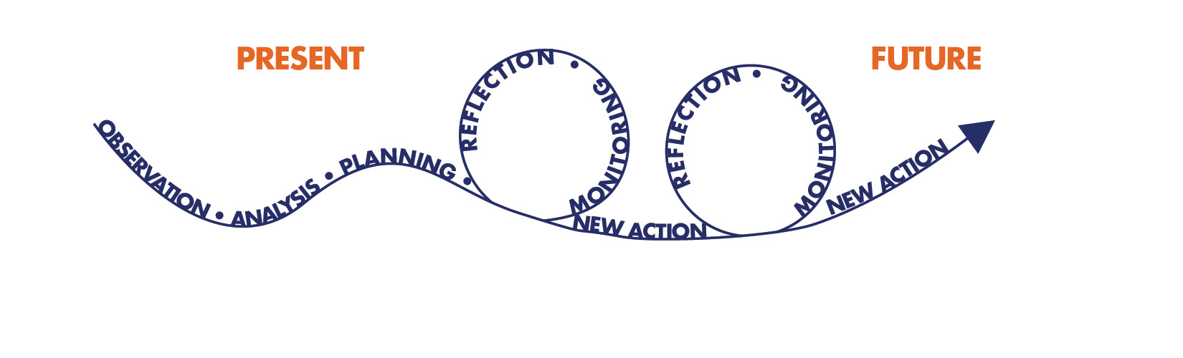
What Is the PM&E Programme Path?
This programme path shows how systemic learning helps us adapt to change.
Source: Evans, K., Larson, A., Mwangi, E., Cronkleton, P., Maravanyika, T., Hernandez, X., . . .Banana, A. (2014). Field guide to adaptive collaborative management and improving women’s participation. Bogor Barat, Indonesia: Center for International Forestry Research (CIFOR). Retrieved from: . Adapted from Colfer, C.J.P. (2005). The complex forest: Community, uncertainty, and adaptive collaborative management. Washington, DC: Resources for the Future/Center for International Forestry Research.
Notes:
Monitoring is about observing and day-to-day tracking of our work. We monitor our work by gathering and recording information over time.
Evaluation is about learning. We evaluate our work by reflecting together on what has been done and making an assessment of our progress thus far.
PM&E is about learning something by doing it together.
Change is okay, if we have learned something new.
We discussed goal statements and indicators to monitor the outcomes we want. We are able to make changes to those goal statements and indicators, if it makes our story stronger.
The PM&E Programme Path illustrates the cycle of observation, analysis, planning, action, then reflection and monitoring, followed by new action and more reflection and monitoring
PM&E is about learning together from our successes, challenges and mistakes. First, communities come together to discuss present concerns. They make a plan of action to address these concerns and they carry out activities to support this plan.
Then, they meet again to discuss their activities and their observations. Based on this meeting and group reflection, they may change some of their plans in order to take better action and make more progress in the future.
This process of monitoring, reflection, and taking new action is repeated as many times as necessary to bring communities closer to their goals.
Source: Evans, K., Larson, A., Mwangi, E., Cronkleton, P., Maravanyika, T., Hernandez, X., . . .Banana, A. (2014). Field guide to adaptive collaborative management and improving women’s participation. Bogor Barat, Indonesia: Center for International Forestry Research (CIFOR). Retrieved from: http://www.cifor.org/publications/pdf_files/Books/ACMManual2014.pdf. Adapted from Colfer, C.J.P. (2005). The complex forest. Communities, uncertainty, and adaptive collaborative management. Washington, DC: Resources for the Future/Center for International Forestry Research.

Slide 26
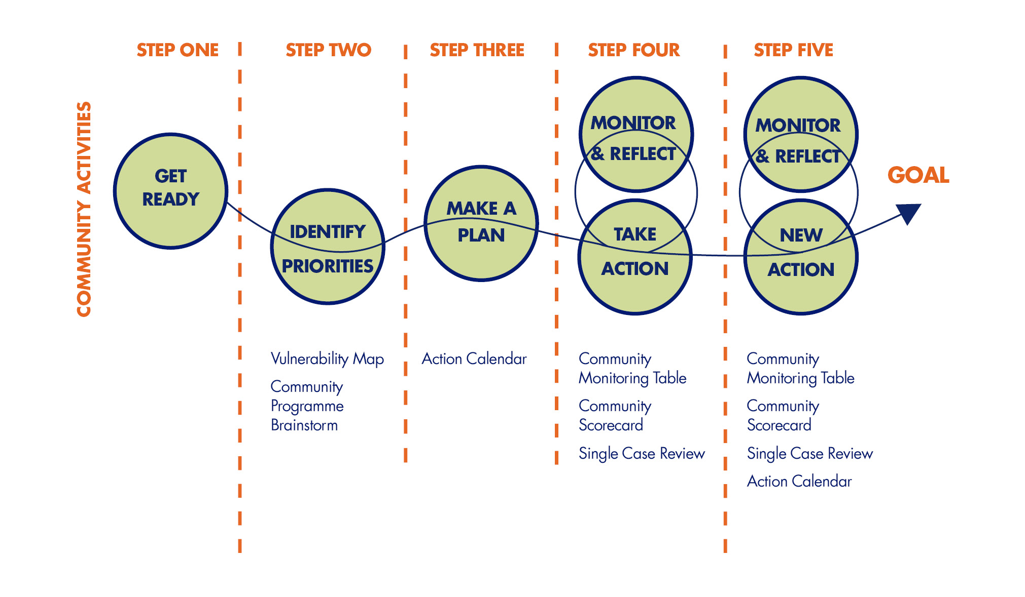
1.Get Ready
Walking the Programme Path
Notes:
The PM&E Programme Path involves 5 steps that are repeated as often as necessary. Each step will require a community meeting. (Later we will introduce tools that will help you with these steps.)
Step 1 is to get ready.
Before you start working in a community, you should engage with community members to gather some general knowledge about their needs and get their buy-in for PM&E. That’s why the first step involves raising community awareness about PM&E activities and getting support.
Do you think this is important? Why? Why not?
[Brainstorm]
How could you prepare the community for PM&E? Are there particular people, leaders, or organisations that could help? What could you do to involve them?
How would you bring the community together? Would you call a meeting? Would one meeting be enough? How would you make the community aware of the purpose, location, or timing of the meeting? Are there any people who might be overlooked, or who might not attend the meeting(s)? What could you do to reach them?
Before conducting these meetings, what are some things you need to do? Who should be involved? Why? What will be discussed at the meetings?
What do we do next? Are there activity reports or plans that you should gather or read before you start working in the community?

Slide 27
2. Identify Priorities
Walking the Programme Path
Notes:
2. Identify priorities.
The second step is about getting the people who work or volunteer with community groups to think about what the community needs and how they can help.
This step involves meeting to talk about the community concerns, discuss what you would like to change, agree on which concerns are most important and which of these you could help change, and then decide on the order in which you will address the concerns identified.
[Brainstorm]
How will you know what the concerns are? How will you decide which ones are most important? In session 2, we will introduce some tools you could use (Community Concerns Brainstorm and Vulnerability Map).
Let’s talk now about some things we need to do to help us to identify priorities. Whom should we involve?
What should we have completed by the end of the meeting? What do we do next?

Slide 28
3. Make a Plan
Walking the Programme Path
Notes:
3. Make a plan.
The third step is about coming to a decision about how you will address the issues identified.
Once you identify the community concerns, you will need a plan of action for how you will provide needed services and monitor changes in the community as a result of having received these services.
[Brainstorm]
What are some things we need to do? What activities might be included in our plan? Who will do them?
What information might we need to record? In Session 2, we will show you some tools you can use to make a detailed plan (Action Calendar and Community Monitoring Table).
What should we have completed by the end of the meeting? What do we do next?

Slide 29
4. Take Action, Then Monitor and Reflect
Walking the Programme Path
Notes:
Step 4 has two parts: take action, then monitor and reflect.
This first part is about taking action. This is where you go out to the villages to carry out the activities described in your plan (and more fully in the Action Calendar and Community Monitoring Table, two tools we will introduce later).
The second part is about monitoring and reflection. This is where members meet with each other to discuss their activities and observations.
[Brainstorm]
How many meetings do you think we might need for this step? Before the meetings, should we have completed any activities? Is this important? Why? How will we discuss what we have learned?
Is it okay to make changes to the plan? How do we record this? We will introduce useful tools in Session 2 that will help you gather and record even more details for your plan (Action Calendar, Community Monitoring Table, and Community Scorecard). What should we have completed by the end of the meeting? What do we do next?

Slide 30
5. Take New Action, Then Monitor and Reflect Again
Walking the Programme Path
Notes:
Step 5. Take new action, then monitor and reflect again.
The fifth step is very much like Step 4. The processes are the same. The only difference is you. Now, you can use what you have learned to improve on programme plans and activities through new action, monitoring, and reflection.
[Brainstorm]
This is a very important step in PM&E. Remember that PM&E is about learning together from our successes and our mistakes. Change is okay. Therefore, this step of taking new action, monitoring, and reflection should be repeated as many times as needed to bring communities closer to their goals. For some activities, this may be the last step of the PM&E process. Can you think of any examples where this might be so?
It is likely that more than one follow-up meeting will be needed and this step will be repeated continually until the goal is reached.
What tools could we use at this meeting? Do you think the tools will be different from those in Step 4? Why?
If change is okay, can we revise the plan if we have ideas to make it better? Can we add new activities? Can we remove activities? How do we record this? What should we have completed by the end of the meeting? What do we do next?
We will talk more about action, monitoring, and reflection in our next session.

Slide 31
Session 2:
PM&E Community Group Tools
Notes:
[List the names of the trainers on the slide.]
Introduce yourself and any other trainers.
Briefly describe the training’s logistics: days, timeframe, facilities.

Slide 32
Role Play
Characters
Female elder with 4 orphans
MVC: A child from a child-headed household
Volunteer with MVC
Member of a most vulnerable children committee (MVCC)
Representative from community women’s group
Representative of village leadership
Volunteer providing home-based care (HBC)
Faith-based leader
Married woman in family with 2 kids
Married man in family with 4 kids
Field officer
Notes:
Before we begin with the first tool--the Vulnerability Map--we need to decide which community we will role-play for this exercise.
Would anyone wish to volunteer the name of the community?
And what organisations and services are involved? Let’s name them.
Which roles do we need to play? You can use some of the characters on the slide for inspiration.
I will play the role of the PM&E facilitator.

Slide 33
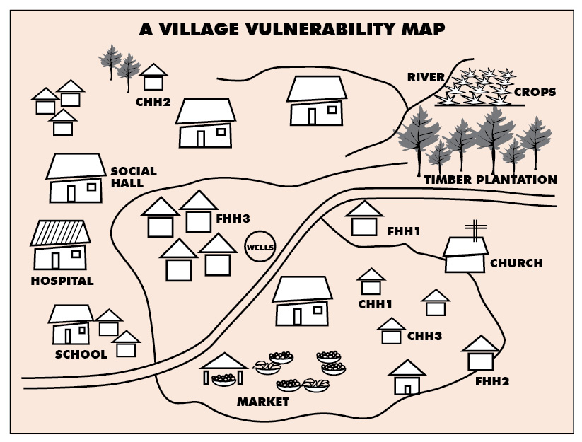
Vulnerability Map
Notes:
The first community group tool we will practice using is the Vulnerability Map for our community.
This tool will help us understand how different households survive and cope in the community.
Understanding different households will help us understand the needs and concerns of the entire community.
Has anyone participated in a community mapping exercise before? Tell us about that.
[If there are more than 10 participants, divide them into smaller groups for this exercise. Each group can draw its Vulnerability Map on flip-chart paper.]
Before we begin, let’s share with one another our ideas of what makes a household. What defines a household?
There are many different types of households that make one community. Tell me about different households.
Today we will draw a map that shows the community resources, such as a school, a health centre, or a river. We will also draw households on the map.
We will not draw all of the houses, but we will try to draw many different types of houses.
Who wants to draw? Please draw your house and then your neighbours’ houses.
Where is the school? Where is the health centre? Can you draw roads and paths? Let’s draw more houses. Let’s draw gardens and livestock.
Can you list all types of households you have in your village (for example, female-headed, child-headed, households with elderly or chronically ill members)?
What services are available in your community? Can you list them and draw them?
What health risks are around the village? What makes households vulnerable? Has it always been this way? How does that household cope with the situation? How does the household access the services?
[Each group will draw a map and compile lists.]
We have identified a few problems in our community. (List examples.)
The different households show us different ways of surviving and coping. (List examples.)
How do households make money? How do households get food?
How do people take care of their health? Where do people get emotional support?
How many vulnerable households have we identified? What types of concerns or vulnerabilities do households in our community face? (List the number of FHH; list the number of CHH.)
[You can reassemble the subgroups as one group again and ask each group to share what they did.]
We’ve talked about all the concerns or vulnerabilities in our community. Now what?
Later in the session, we will have an opportunity to discuss these issues, and ways to address them, using the Programme Action Calendar tool.

Slide 34
Community Concerns Brainstorm
Priority | Concern | Reasons | Resources
Notes:
Now we are going to use another tool to help us identify community issues. This is called the “Community Concerns Brainstorm.” Our purpose is to gather community concerns about the MVC/HBC programme.
Brainstorming is a group exercise. First, members of the group call out many ideas, concerns, and examples.
No ideas are wrong. All ideas are welcome.
Once we have a list of concerns, the participants choose which concerns are most important or most urgent.
[Divide them into smaller groups of 6 to10 people if the total group has 12 or more people.]
Each group can draw a Community Concerns Brainstorm table using the one on the slide as a model.
First, let’s confirm the geographic area the MVC/HBC programme covers. Can someone describe that for us? [Note this on the flip chart.]
And, let’s confirm the types of services and the names of organisations that are involved in the MVC/HBC programme. Can someone list those for us? [List them on the flip chart.]
Tell us about your programme. How are things going?
What do you need that you do not have? What do families need?
What services are available, but people are not accessing them?
What works well? What does not work well?
How can we prioritize?
Let’s consider which concerns are directly related to MVC and HBC programmes.
Which concerns are most important?
Which concerns are most urgent?
Each group can whittle down their list by checking off their top three concerns, and/or the whole group can discuss all of the concerns and check off the top three they consider to be most urgent.
In the next module, we will learn how to use the Action Calendar tool to plan how to respond to our top concerns.

Slide 35
Action Calendar
What activities are expected? | What needs to be done to make the activity happen? | Person responsible | Week 1 | Week 2 | Week 3 | Comments
Provide school supplies and uniforms to children in need. | Count children in need (with ages and genders). | Member A
 | Raise money. | Member B | X
 | Get list of needed supplies from school by year. |  |  | X
Notes:
Here is an example of an Action Calendar. This is another tool to help us respond to concerns in our community. This will help us identify the actions we would like to take and create a plan to conduct effective activities over a specific timeline.
Planning is simply using knowledge and experience you already have to lay out the steps it takes to succeed or be on time.
Planning is an activity that we all do. We plan our meals. We plan the chores we will do in one day or in one week.
Let’s use the flip-chart paper to create our own Action Calendar(s). [This can be done in smaller subgroups if necessary.]
Decide what activities are needed, how often they should be done, who needs to do them, and how often they need to be discussed. This is how we start to build our Action Calendar.
What activities are expected?
What needs to be done to make the activity happen?
When do we do it? Who does it?
Now look at the Action Calendar. How often should Member A share the group’s progress? If the activity should be shared every month, the group should gather together to discuss that activity each month. If the activity should be shared once a year, then the group should meet to discuss that activity each year. Let’s plan when we should meet based on our Action Calendar.
Once the group has agreed upon activities for the MVC/HBC programme, the group members who are responsible for completing the activities will need calendars.
Blank notebooks will work best, but single sheets of paper may also be used. Let’s draw a calendar for each member now.
Now look at your calendars. When is Member X expected to complete an action? When is the action up for discussion? If the activity should be shared in the summer, then the group should meet to discuss that activity the summer.

Slide 36
Community Monitoring Table
Indicator monitoring activity | Person responsible | When to report | Jan | Feb | Mar | Apr | May | Jun | Total | Target | Notes
# of MVC who are not going to school | Volunteer | Mar Jun |  |  | 15 |  |  | 10 |  |  | 5
# of MVC who received at least one care service | Volunteer | Mar Jun |  |  | 20 |  |  | 21 |  |  | 25
# of MVC caregivers who are interviewed during home visit for care plan | Volunteer | Mar Jun |  |  | 3 |  |  | 0 |  |  | 2
Notes:
Now we are going to learn about another community group tool, called a Community Monitoring Table, shown on the slide.
The Community Monitoring Table will help you monitor the supplies and services provided by the MVC/HBC in our community.
We will learn how this works by creating and completing a Community Monitoring Table during this exercise.
Monitoring is simply gathering information to look for changes over time.
Monitoring is an activity that we all do to keep track of something; we just don’t call it “monitoring.” We monitor our kids. We monitor our food. We monitor our crops. We monitor the amount of money we have to spend.
Monitoring is about tracking changes. When we monitor, we watch what is happening to see if things have changed. Therefore, in order to be sure of change, we should carry out our monitoring activities more than once, and always keep records of how things were in the past. Because of this, monitoring activities must also include taking notes.
A monitoring activity can be an observation, a count, or a measure recorded over time. For example, a mother observes that her child has a cough for three days, or a teacher counts the number of children who attend class each day, or the nurse measures the weight of your child at each visit.
A good monitoring activity records something very specific and something you can measure easily, such as the number of days a child has a cough, the number of children in attendance at school, and the weight of a child over the first year of life.
Let’s use the example of you taking your child to the clinic.
The nurse may measure and record the child’s weight. If the nurse didn’t do this at each visit, it would be difficult to know if your child was growing.
The same goes for our work. Once the observations or counts have been recorded, the information should be discussed among the group. Then everyone will know the information, and everyone has a chance to share what they think the information means to the community programme.
To monitor your programme well, you collect information at the beginning, middle, and end, so that you can track whether you are making progress in your community.
Let’s decide what monitoring activities are needed, how often they should be done, who needs to do them, and how often they need to be discussed. (You can draw from the Community Concerns Brainstorm or create new activities during this discussion.)
If we choose monitoring activities that count people, we will try to separate people by gender and then by age, location, type of household, or other important information. This is important, because people are not the same, and depending on their gender, age, and other characteristics, their situations may change.
[Break into smaller subgroups if necessary and ask each to discuss what activities they wish to monitor and use the model on the screen to create their Community Monitoring Table.]

Slide 37

Community Scorecard
Progress Scores
Notes:
Now we are going to complete an exercise using another tool called the Community Scorecard.
The purpose of this exercise is to help us understand how well MVC/HBC services change lives in our community.
Has anyone used the scorecard before? Tell us about that.
The Community Scorecard is meant to provide “quality scores” so that we can improve service delivery and communication in the community. IT IS NOT ABOUT PLACING BLAME. IT IS NOT ABOUT POINTING FINGERS. Do not look at people or individuals but rather at programmes and policies.
Tell us about some general issues with certain aspects of your programme and the types of services offered.
What is the role of the community in service delivery?
What types of things can we discuss today using the Community Scorecard?
A quality score can be an observation, a feeling, or an opinion recorded over time.
For the Community Scorecard to work well, observations, feelings, or opinions should be very specific and likely to change over time.
An example of an observation score is a test grade. The teacher observes the number of mistakes a child makes on a test and provides a score.
“I like mangos” is a feeling or an opinion, but it is not a good opinion score, because it is unlikely my opinion about mangos will change. “I had enough mangos to eat this week” is a good opinion score, because it allows my feeling or opinion to change over time.
Another good quality score could be, “MVC households get the assistance they need from the MVC programme.” Or “income-generating groups provide me with the things I need to start my own business.”

Slide 38


Community Scorecard
Date: Programme Area: Facilitator Name:
 | Very Bad | Bad | Just Okay | Good | Very Good | Reasons | Action
Observation/Opinion | 1 | 2 | 3 | 4 | 5
School supplies are available on time for every child in need. |  |  |  |  |  | Every child gets something, but the supplies do not arrive on time and are not enough for the whole year. | Arrange for more supplies to arrive earlier in the year.
Clients always feel comfortable asking questions. |  |  |  |  |  | The HBC worker is just like us. She understands our needs. | Recognize the HBC worker for her good work.
Notes:
Here is what a Community Scorecard looks like.
The first column lists observations or opinions.
The next columns allow you to “rate” the statement using an emoticon.
The next to last column is where you can provide a reason for your rating.
And the last column is where you describe an action that might improve the score over time.
Let’s fill in a Community Scorecard of our chosen community. [Use 2 pieces of flip-chart paper taped together so it is wide enough for all of the columns.]
Let’s make sure we agree on the types of services and the names of organisations that are involved in the MVC/HBC programme.
Now let’s make a final list of community concerns or community services that we want to learn more about.
We will start with the list we have here, and add any new concerns to your Community Scorecard.
[Continued on the next slide]

Slide 39
Community Scorecard
Date: Programme Area: Facilitator Name:
 | Very Bad | Bad | Just Okay | Good | Very Good | Reasons | Action
Observation/Opinion | 1 | 2 | 3 | 4 | 5
School supplies are available on time for every child in need. |  |  |  |  |  | Every child gets something, but the supplies do not arrive on time and are not enough for the whole year. | Arrange for more supplies to arrive earlier in the year.
Clients always feel comfortable asking questions. |  |  |  |  |  | The HBC worker is just like us. She understands our needs. | Recognize the HBC worker for her good work.
Notes:
Let’s talk about how some services may make us feel.
Sometimes we can tell a lot about how people feel by their faces. A big smile may mean that they are “very good.” A little smile may mean they are “good,” and no smile means they are “just okay.” Use the emoticons to give the following scores: very good, good, just okay, bad, or very bad.
If you answer that the service is good today and very good next month, then we can say the service is improving.
If you answer the service is good today and bad next month and very bad the month after that, then we can say the service is declining.
[Break into subgroups of all providers and all clients.]
The facilitators will lead each group to choose a score for each observation or opinion listed on the card. The scorecard may look a little different for providers and clients.
We will help the groups decide if there is an observation or opinion they feel they cannot score, and it will be left off the scorecard for that group.
We will need to record the quality scores for each issue. We will vote if it is necessary.
It is also important to note the reasons for your score. Record your thoughts, feelings, and opinions. Explain why the service is or is not changing lives in the community.
How do you feel about the scores? What can we do to improve low scores? What can we do to maintain high scores?
Let’s decide what activities are needed, how often they should be done, who needs to do them, and how often they need to be discussed. These can be added to the Activity Calendar and the Community Monitoring Table you completed in the earlier modules.

Slide 40

Single Case Review
Did you identify a vulnerable child or household?
What were the concerns?
What (activities) did you do to address this concern?
How did you know if things had changed?
How did you decide which concern to address first?
Were you able to address all the issues?
Was there anything you are proud of?
What would you have done differently?
What other materials or support might have helped you with this case?
Notes:
Now we are going to use another useful tool called the Single Case Review.
The purpose of the Single Case Review is to help us understand how well MVC/HBC services change lives in our community.
The Single Case Review is a learning opportunity. We will look at one particular case in great detail.
The case does not have to be difficult. One person tells the rest of the group about a situation where she or he helped a child, an individual, or a household to receive needed services.
The rest of the group then participates, by asking questions, sharing experiences, and learning from one another.
The result is a powerful story, a living example of how our services can improve lives in our community.
[Ask for a volunteer to share a case. The questions on the slide can help provoke discussion to develop the case review. If you or the participants don’t have a case story in mind, you can use an example from the appendixes.]
[You can use the following questions to continue a discussion of the value of this exercise.]
Has anyone worked on a case that was similar to this one? How was it similar? How was it different?
Were there any other concerns? How did you deal with them?
Did you need or get any additional support to help manage the case? Tell us about that. Was it helpful?
Is there anything you would do differently if you were to encounter a similar case again? What would that be? Why?
We know that vulnerable people may need help getting healthcare, education, and food. But they may also need other types of support.
How do you think vulnerable people in your community feel? Are they embarrassed? Do they feel ignored, unimportant, or unheard?
How do they feel about receiving goods and services? Are they more confident? Are they ashamed?
Tell me about some of the attitudes in your community.
We have identified some important points to remember when working in the community. [List a few key points on the flip chart.]
Every individual is vulnerable in different ways. [List some types of support that vulnerable people need and some ways to help them.]
This is a powerful way to talk about the impact of our services. It’s also another good way to talk about the concerns and vulnerabilities in our community programme.
You can add this method to the other methods we practiced earlier: the Vulnerability Map and the Community Brainstorm.
You also may wish to add these concerns to your Action Calendar, your Community Monitoring Table, and/or your Community Scorecard, to track ways to address concerns, monitor your responses, and rate the services related to your responses.

Slide 41
Session 3:
Reflection and Action
Notes:
[List the names of the trainers on the slide.]
Introduce yourself and any other trainers.
Briefly describe the training’s logistics: days, timeframe, facilities.

Slide 42
Reflect, Then Take Action
Notes:
Evaluation is about measuring change. Evaluation is also about learning.
After we have completed some or all of our activities, we can learn from the process by reflecting on what worked well and what did not work well and deciding how we can do the same thing(s) better.
Let’s look again at Step 4 of the PM&E Programme Path, which tells us to take action, then monitor and reflect.
Every meeting where we come together to reflect on our plans and activities is an opportunity to reflect on our work.
Participatory evaluation involves discussion, reflection, and decision making.
How can we use the information from these meetings?
Would we need to make any preparations to be able to use this information? Why or why not?

Slide 43
5 Components of Evaluation
Strong goal statement
Programme or set of activities
Timeline
People to record monitoring activities and progress scores
People to make comparisons, reflect, and act
Notes:
When we evaluate, we are looking closely at the information we have gathered in order to assess change.
In this way, programme evaluations can help you to identify and understand the outcomes of your programme—that is, the endings to your story.
The five parts of an evaluation are:
A strong goal statement (happy endings; fruit)
A programme or set of activities
A timeline (which month does the programme start; which month does it end?)
People to record monitoring activities and quality scores
People to make comparisons, reflect, and act
Use the programme goal that was set at the beginning.
The programme goal statement includes the period that was planned to reach that goal.
Record the month the programme started and record the month it will end.

Slide 44
Use Your M&E Model to Tell a Better Story
Increase the number of children who complete secondary school in the community in five years.
Books and teachers
(Inputs)
Children enrolled in school
(Activities)
Children learning
(Outputs)
Community leaders
(Outcomes)
Notes:
Remember the strong goal statement: Increase the number of children who complete secondary school in the community in five years.
Remember the simple M&E model?
What is the specific period in which we expect to reach our goal?
What details are we looking for?
What indicators can tell our story?

Slide 45
Tell Your Story: List Indicators
Goal statement:
List your indicators here:
Notes:
We’ve talked about how to prepare for an evaluation. Now, let’s discuss how we can go about evaluating our programmes.
What was our goal? What information do we use to determine if we reached our goal? Where do we get this information?
Which specific tools are useful for your evaluation? What indicators (monitoring activities or quality scores) are important details to tell your story. Use the M&E model as the outline to the story.
Could we use our monitoring data? How? (Monitoring Tables)
Think about the possible effects of our activities on people who have received services. Do we have this information? How could we use it to understand different perspectives and experiences? (Community Scorecards and Case Reviews)
Think about effects on communities. Do we have information on how they have been positively or negatively affected by programme activities? Why is this important? (Vulnerability Mapping and Community Scorecards)

Slide 46
Prepare for the Reflection Meeting
Record information
Think about comparisons
Record comparisons
4. Discuss comparisons
Notes:
Good planning and preparation are necessary for a good reflection meeting. Let’s talk about some things we might need to prepare to ensure a good meeting.
If we want to reflect on information that has been recorded over time, we need to do four things.
First, we need to record the information.
Second, we need to think about comparisons. Someone will need to organize or tally the information, so that final comparisons can be made. We can compare information using time, gender, age, location, or type of household. But you must have recorded that information in your Monitoring Table or Community Scorecard.
Third, we need to record the comparisons. Someone should write these observations down.
For example, more boys than girls go to school.
Fourth, we need to discuss the comparisons. What do these comparisons mean? What do we want to do about this new information?
For example, why are more boys than girls in school? Do we want to increase the number of girls in school? How can we increase the number of girls going to school? How can we continue to support boys going to school?
You will need to decide together on when a programme reflection meeting will be most useful. There is no one time that will be best for every programme. the decision is up to you.
What are some things that might influence this decision?
Think about your programmes and the work you do. Tell us again about some of the activities you do to support vulnerable children and families. How often do you do them? Does everyone take part in the same activities?
What about the information collected? How often will it be gathered? Who will be responsible? One person or many people?
We can use our M&E model and selected PM&E tools to organize the answers to these questions.
Who should be involved in the preparation for the meeting and who should be invited? Consider involving outsiders for new ideas.

Slide 47
Reflection
How can you use monitoring information to tell a story?
How can you present the information for group discussion?
What discussion questions can you prepare for the reflection meeting?
Let the group decide what story can be told with PM&E information.
Notes:
We noted that before an evaluation can take place, the PM&E facilitator should organize all the information collected so that patterns can be observed and comparisons made.
Once the PM&E facilitator has organized and tallied all of the information, how can the information be used to tell a story?
How can the information be presented for discussion among the group?
What discussion questions can you prepare for the reflection meeting?
Let the group decide what story can be told with PM&E information.
Let’s say that you decide to plan your first evaluation after one year. You could look at changes over time, using information from the start of the programme and comparing it to information at the end of the year. You could also use the information gathered during the year to better understand what worked and what did not work and to discuss lessons learned.

Slide 48
Comparisons
Time: Does the information change from month to month, quarter to quarter, year to year?
Gender: Are the outcomes different between vulnerable girls and boys?
Age groups: Have younger people been assisted better than older ones?
Location: Have some locations not been reached with services?
Activities: Were some activities more successful than others?
Notes:
There are no right or wrong answers in an analysis; just good questions! You may choose to compare the information by: [read bullet points from slide]
What other comparisons might you find in your programmes? How could you use this information to improve your work and take new action?
Don’t forget to build these into your monitoring activities or your quality scores.

Slide 49
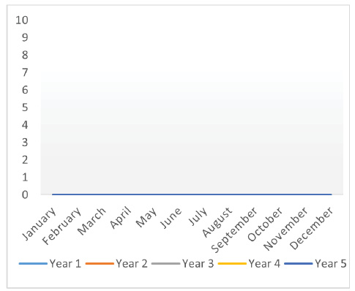
Plot Graph by Ones
Notes:
Use Plot Graphs to tell a story using information from the PM&E tools.
Ask the group to review the information provided by the PM&E tools from Session 2.
Draw at least four types of empty plot graphs (or show Slides 49 to 52.)
Ask the group to match the data from the PM&E tools with the best Plot Graph.
The examples are just guides. Feel free to plot the data to tell the stories you think are most relevant, or the explanations you feel are most needed. Discuss how comparisons of different groups could be displayed on the graph (boys vs. girls, Village A vs. Village B vs. Village C, Year 1 vs. Year 2). Discuss what can be learnt from the graph(s) and whether this information is important. Ask the group to suggest how information from the graph can inform what we do next.

Slide 50
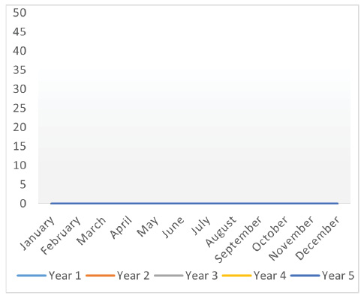
Plot Graph by Fives
Notes:
Ask the group to match the data from the PM&E tools with the best Plot Graph.

Slide 51
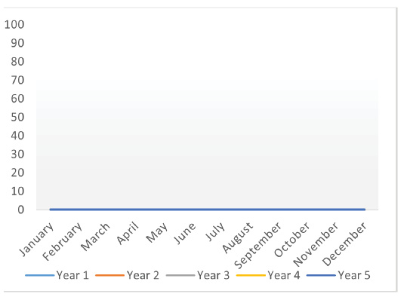
Plot Graph by Tens
Notes:
Ask the group to match the data from the PM&E tools with the best Plot Graph.

Slide 52
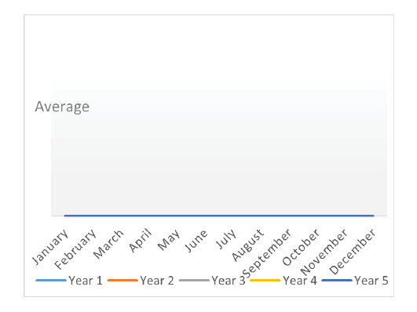
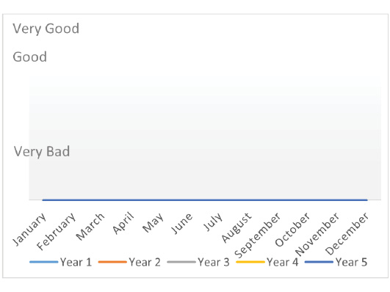
Plot Graph by Categories
Above Average
Just Okay
Bad
Below Average
Notes:
Ask the group to match the data from the PM&E tools with the best plot graph.

Slide 53
Take Action
Uses of Programme Evaluation
Improve the programme based on knowledge of what worked well and what did not work.
Acknowledge the hard work of members and volunteers.
Celebrate successses as a team.
Make a plan for moving forward.
Notes:
Let’s plan a participatory evaluation process.
We will use the strong goal statements, M&E models, and indicators that your small group developed in Session 1.
Break out into your small groups again. You may review and revise the work you have done. Your group should also identify which PM&E tools might be appropriate to collect the indicators/details. The group should identify the evaluation timeframe using the strong goal statement.
When your group presents, use the programme path to illustrate when the indicators are identified, when the indicators are collected, how long you collect the indicators, when you reflect, and when you act.
Remember that PM&E is about learning together from our successes and our mistakes.
The programme evaluation is not just about reporting to donors and international NGOs. It is an opportunity for us to learn and improve how we manage ourselves, our resources, and our work in the communities.
Who might we want to share the results of our evaluation with? Why?
How else can we use our programme evaluation?
Think about the plans you have made and the work you have done in your communities. How could you use the information from a programme evaluation to improve your work and action?
Were all the planned activities carried out? Why? Why not?
Did these activities achieve the intended results? Did the project achieve more than was planned? What worked well? What did not work well? What could have been done differently?
Did you know about activities that MVCCs and other volunteers were doing in other areas? Could you use these in your area(s)?
Did you make any changes going forward? Why or why not? How did you or your group decide on what should change?

Slide 54
Session 4:
Community Practice
Notes:
[List the names of the trainers on the slide.]
Introduce yourself and any other trainers.
Briefly describe the training’s logistics: days, timeframe, facilities.

Slide 55
Thank you
for your participation.
Notes:
[List the names of the trainers on the slide.]
Introduce yourself and any other trainers.
Briefly describe the training’s logistics: days, timeframe, facilities.

Slide 56
MEASURE Evaluation-Tanzania is funded by the United States Agency for International Development (USAID) through associate award AID-621-LA-14-0001 and is implemented by the Carolina Population Center at the University of North Carolina at Chapel Hill, in partnership with ICF International; John Snow, Inc., Management Sciences for Health; Palladium; and Tulane University. The views expressed in this publication do not necessarily reflect the views of USAID or the United States government.
www.measureevaluation.org/tanzania
Notes:
[Update as needed.]

